Slide 1
Water Circulation Guide
Starting the Water Circulation:
Start
Inlet completely filled with water?
No
Prime the pump
Yes
Turn the pump on
Water flowing through outlet?
No
Yes
Can turn the chiller on
If the pump is making noise, check the priming. If the noise persists replace the mechanical seal.

Slide 2
Water Circulation Guide
Stopping the Water Circulation:
Start
Is the chiller on?
No
Yes
Turn the chiller off
Turn the pump off
It is important to turn the chiller off if there is no water circulation to prevent the damage to the chiller.

Slide 3
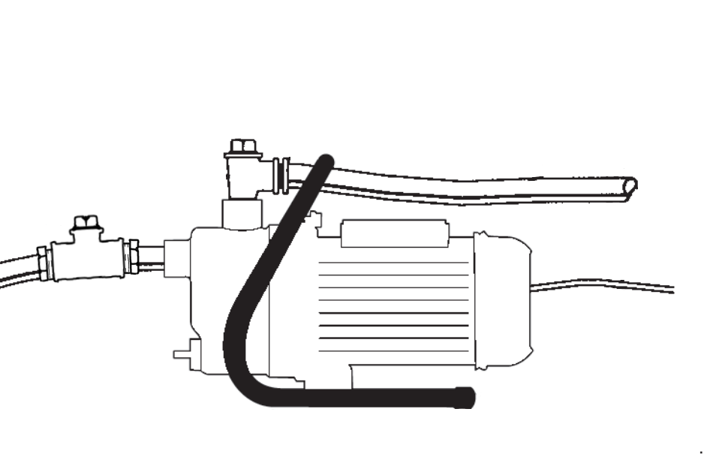
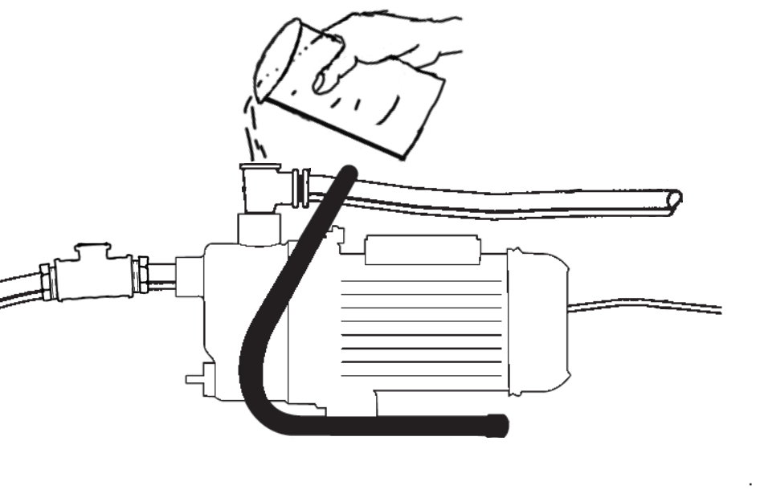
Pump Priming Guide
Open both inlet and outlet ports by removing the plug.
Outlet plug
Inlet plug
Fig 1: Red Lion RJSE-75SS pump
2. Fill the outlet port with water (as shown in Fig 2) until the inlet line and the pump body are completely filled with water.
You may need to shake the inlet line to help trapped air escape.
It is important to have both port open to allow the air from the inlet and pump body to escape.
Fig 2: Priming the pump
3. Close both inlet and outlet ports.
If properly primed, the unit should start pumping immediately. If not repeat the priming procedure.

